Slide 1
CS419 Recitation Class
Webex: https://rutgers.webex.com/meet/sy558
every Monday's 7:00-8:00 pm
Notes:
/krɪpˈtɑːɡrəfi/

Slide 2
CS419 Recitation Class
Topic：Network Security & Malwares & OS Basics
Notes:
/krɪpˈtɑːɡrəfi/

Slide 3
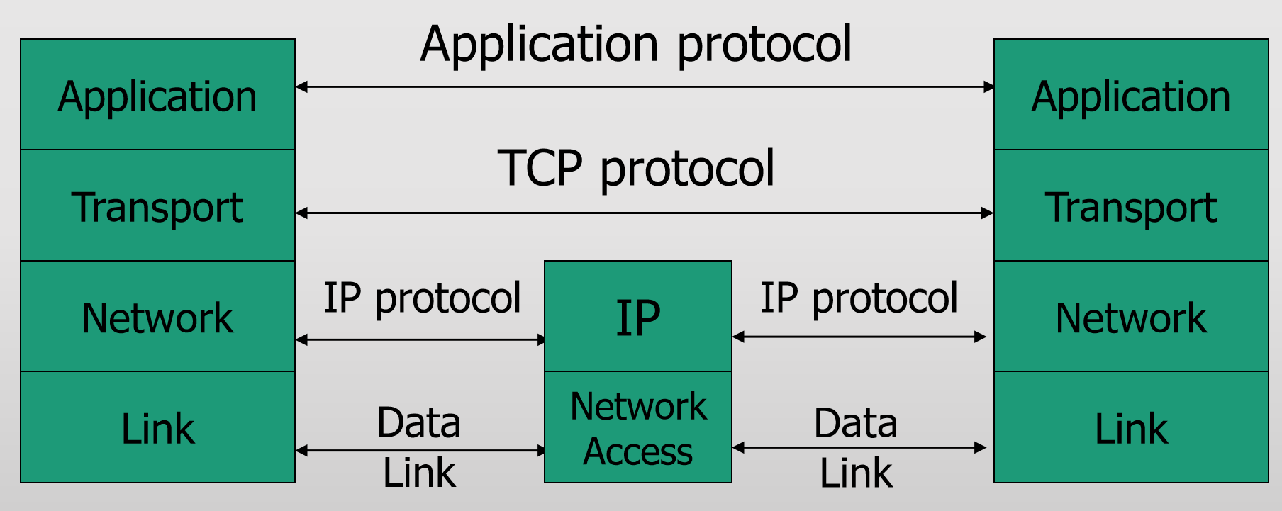
Network Security
Types of Addresses in Internet
• Media Access Control (MAC) addresses in the network access layer
• Associated w/ network interface card (NIC)
• 48 bits or 64 bits
• IP addresses for the network layer
• 32 bits for IPv4, and 128 bits for IPv6
• E.g., 128.3.23.3
• IP addresses + ports for the transport layer
• E.g., 128.3.23.3:80
• Domain names for the application/human layer
• E.g., www.rutgers.edu
Network Protocols Stack:
Routing and Translation of Addresses
• Translation between IP addresses and MAC addresses
• Address Resolution Protocol (ARP) for IPv4
• Neighbor Discovery Protocol (NDP) for IPv6
• Routing with IP addresses
• TCP, UDP, IP for routing packets, connections
• Border Gateway Protocol for routing table updates
• Translation between IP addresses and domain names
• Domain Name System (DNS)
Notes:
/,stegə'nɔgrəfi/

Slide 4
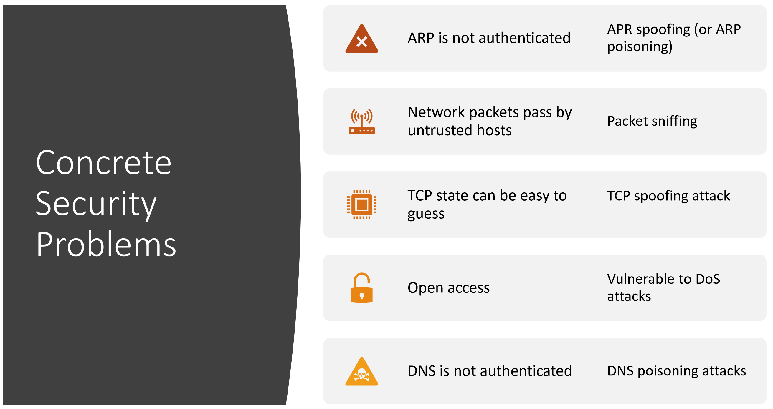

Slide 5
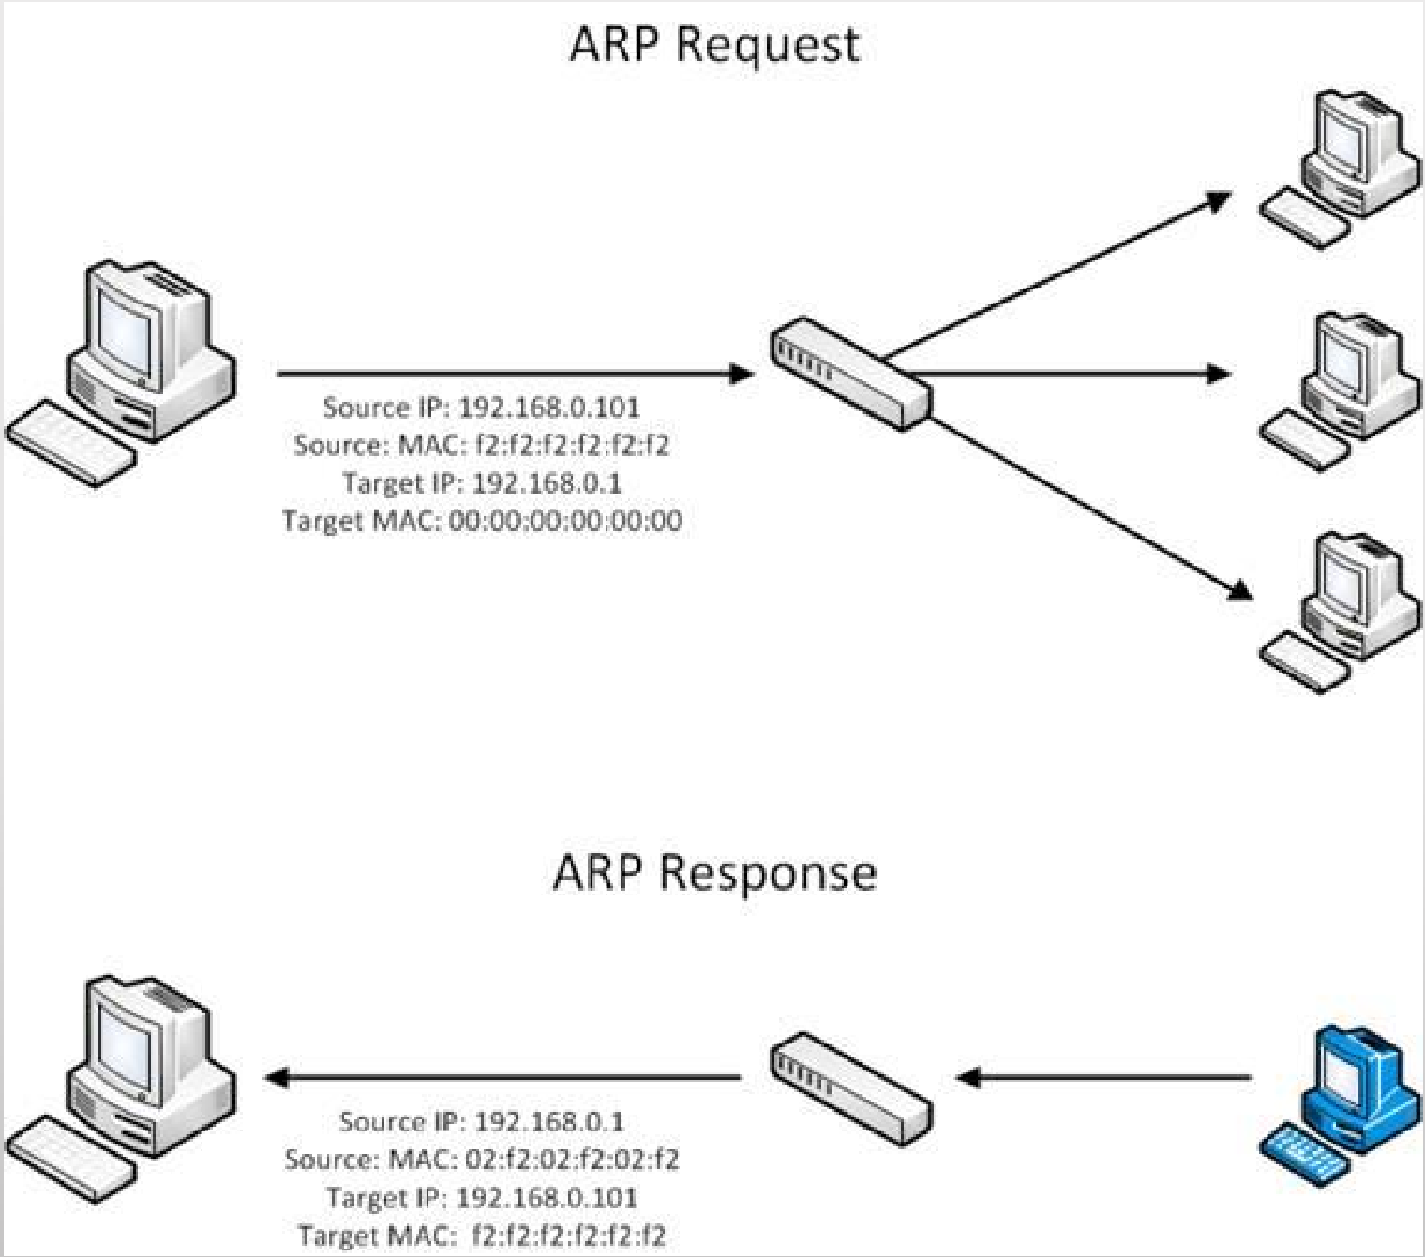
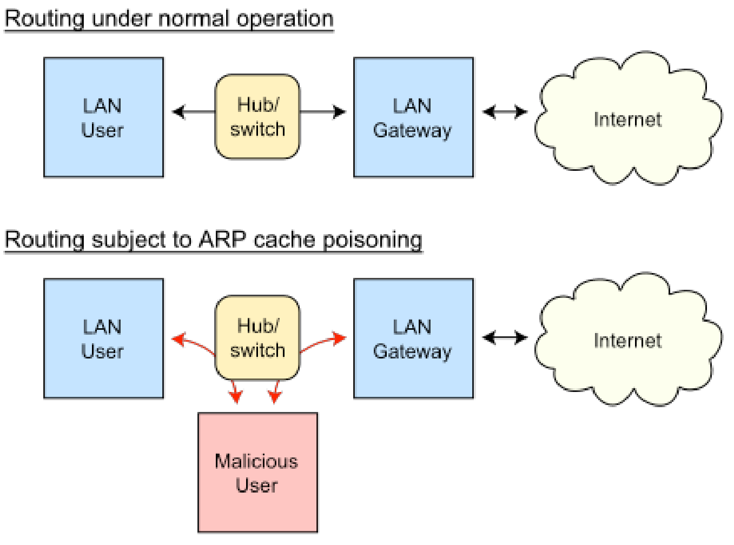
ARP Spoofing
Address Resolution Protocol (ARP)
• Primarily used to translate IP addresses to Ethernet MAC addresses
• Send fake or 'spoofed' ARP messages to an Ethernet LAN.
• To have other machines associate IP addresses with the attacker’s MAC
so that any traffic meant for the target host will be sent to the attacker's host.
The attacker may choose to inspect the packets (spying), while forwarding the traffic to the actual default destination to avoid discovery, modify the data before forwarding it (man-in-the-middle attack), or launch a denial-of-service attack by causing some or all of the packets on the network to be dropped.
• Defenses
• static ARP table
• DHCP Certification (use access control to ensure that hosts only use the IP addresses assigned to them, and that only authorized DHCP servers are accessible).
• detection: Arpwatch (sending email when updates occur)

Slide 7
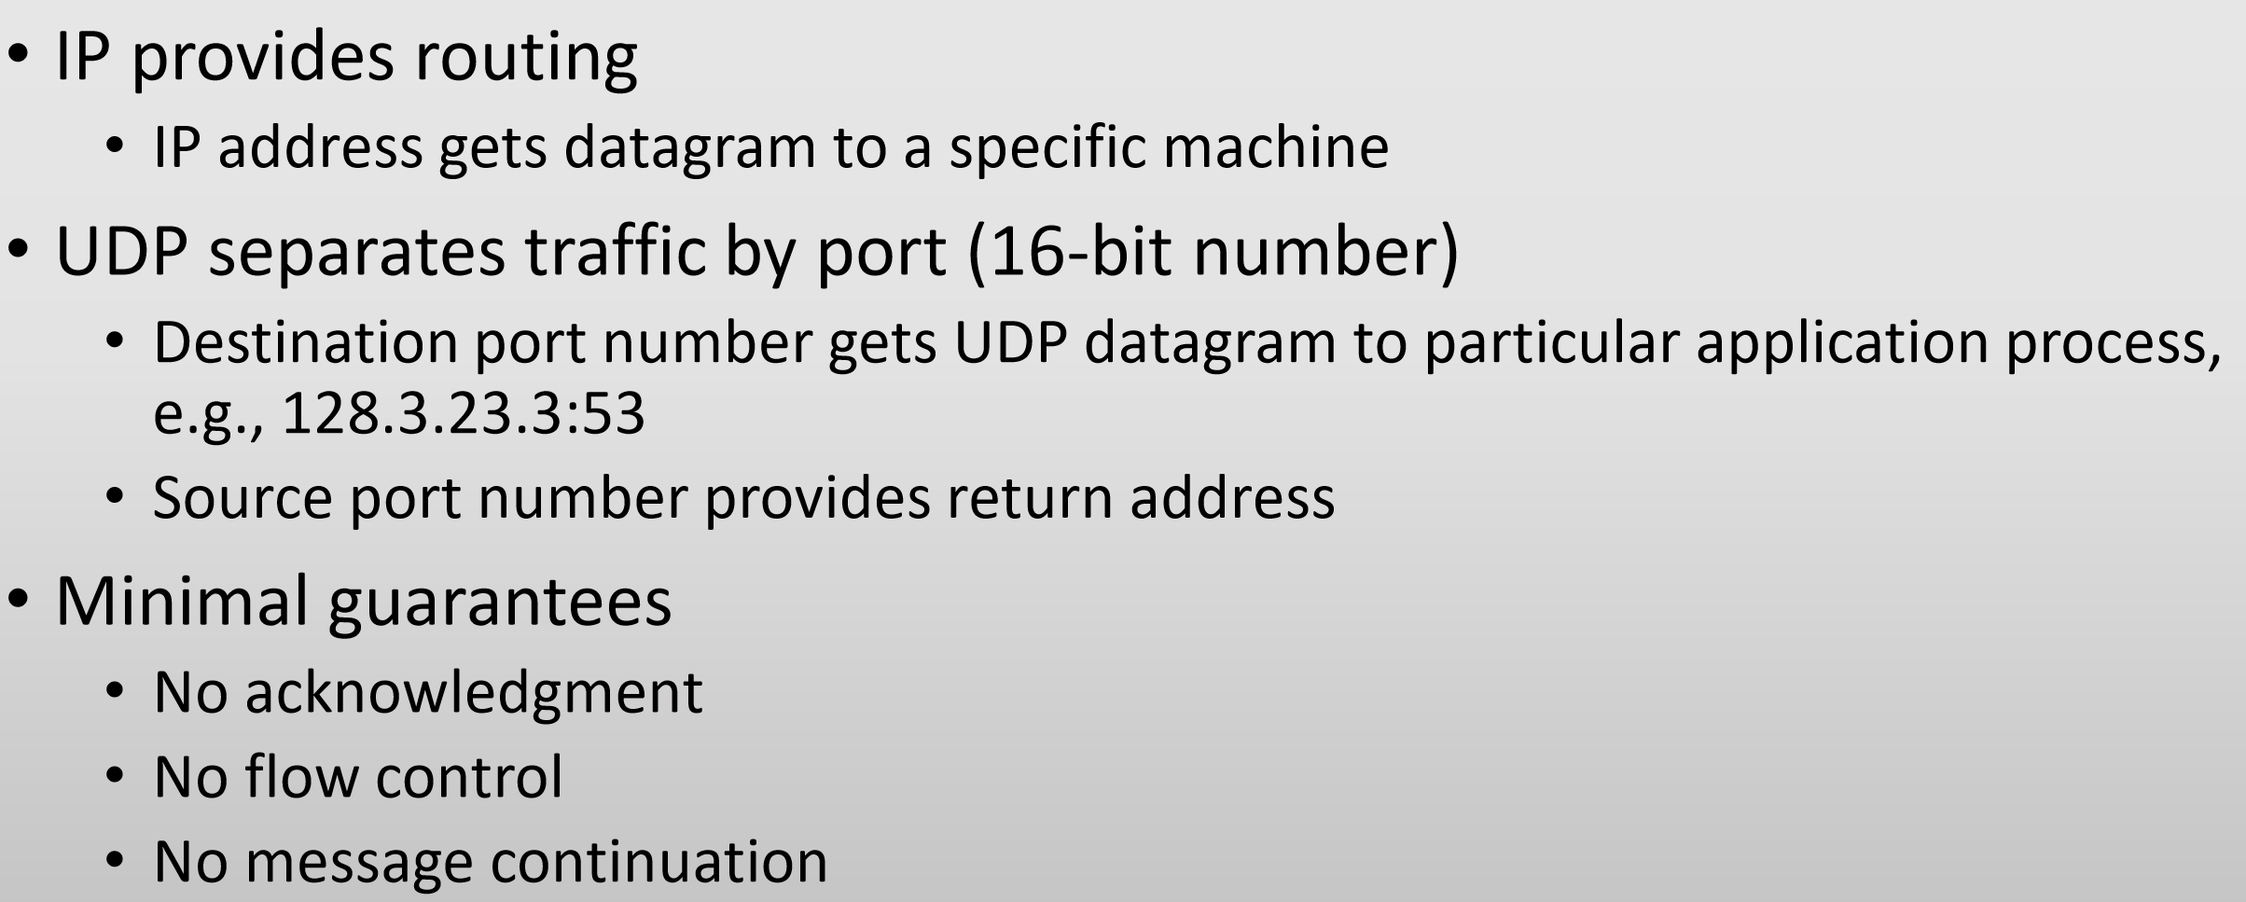
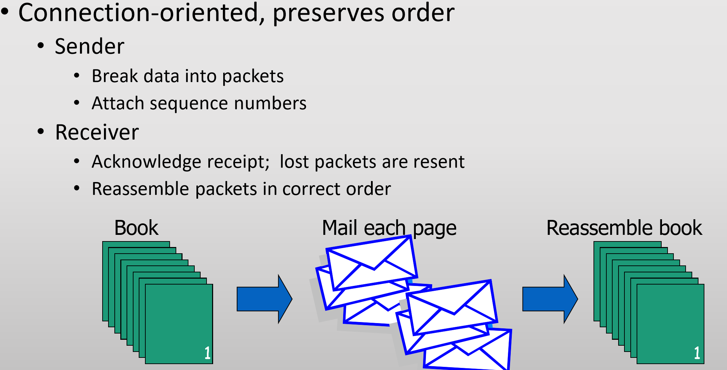
• Routing with IP addresses
• TCP, UDP, IP for routing packets, connections
• Border Gateway Protocol for routing table updates
User Datagram Protocol (UDP):
Transmission Control Protocol (TCP):

Slide 8
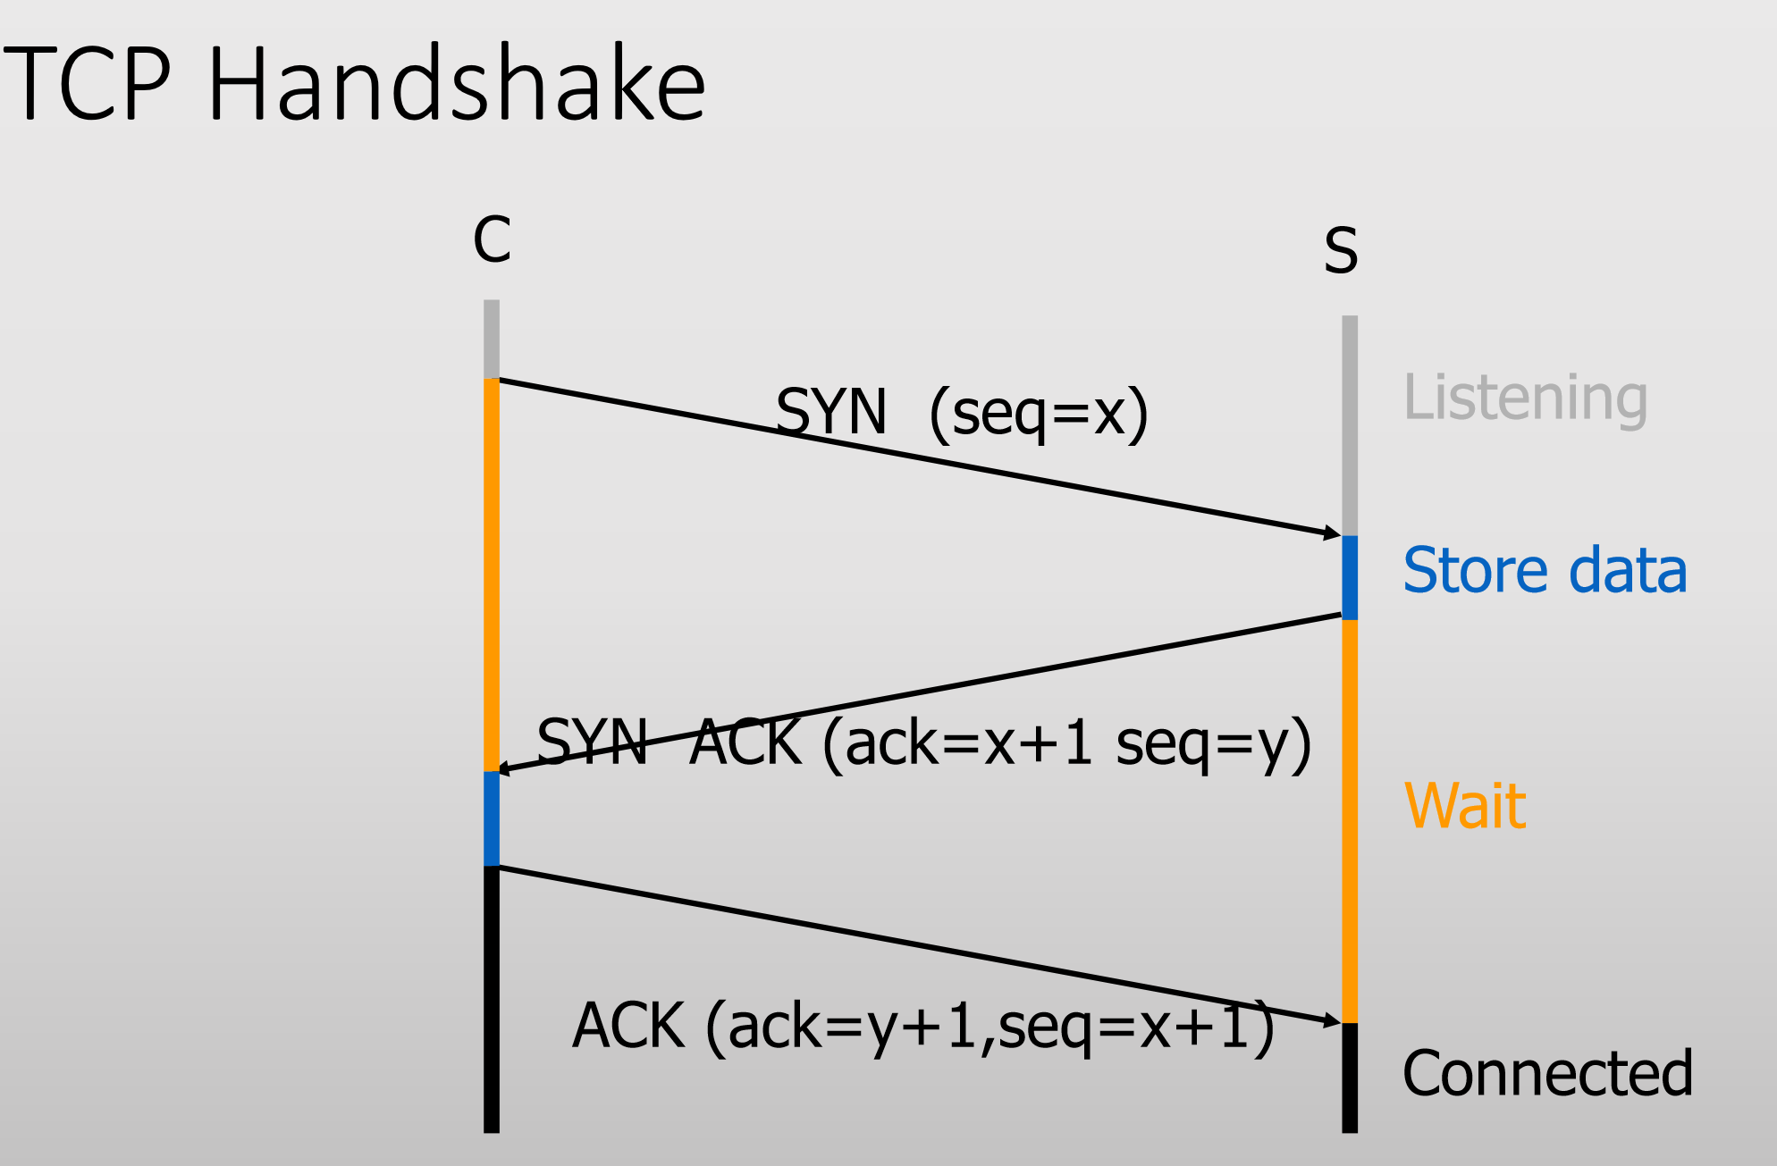
TCP sequence prediction attack
Connection Establishment:
TCP state can be easy to guess:
Predict the sequence number used to identify the packets in a TCP connection, and then counterfeit packets.
• Adversary: do not have full control over the network, but can inject packets with fake source IP addresses
• E.g., control a computer on the local network
• TCP sequence numbers are used for authenticating packets
• Initial seq# needs high degree of unpredictability
• If attacker knows initial seq # and amount of traffic sent, can estimate likely current values
TCP Sequence Numbers:
• Sequence number (32 bits) – has a dual role:
• If the SYN flag is set, then this is the initial sequence number. The sequence number of the actual first data byte is this sequence number plus 1.
• If the SYN flag is clear, then this is the accumulated sequence number of the first data byte of this packet for the current session.
• Acknowledgment number (32 bits) –
• If the ACK flag is set then this the next sequence number that the receiver is expecting.
• This acknowledges receipt of all prior bytes (if any).

Slide 9
Denial-of-service Attacks:
1. SYN Flooding
2. Smurf DoS Attack
3. Distributed DoS (DDoS) Attack

Slide 10
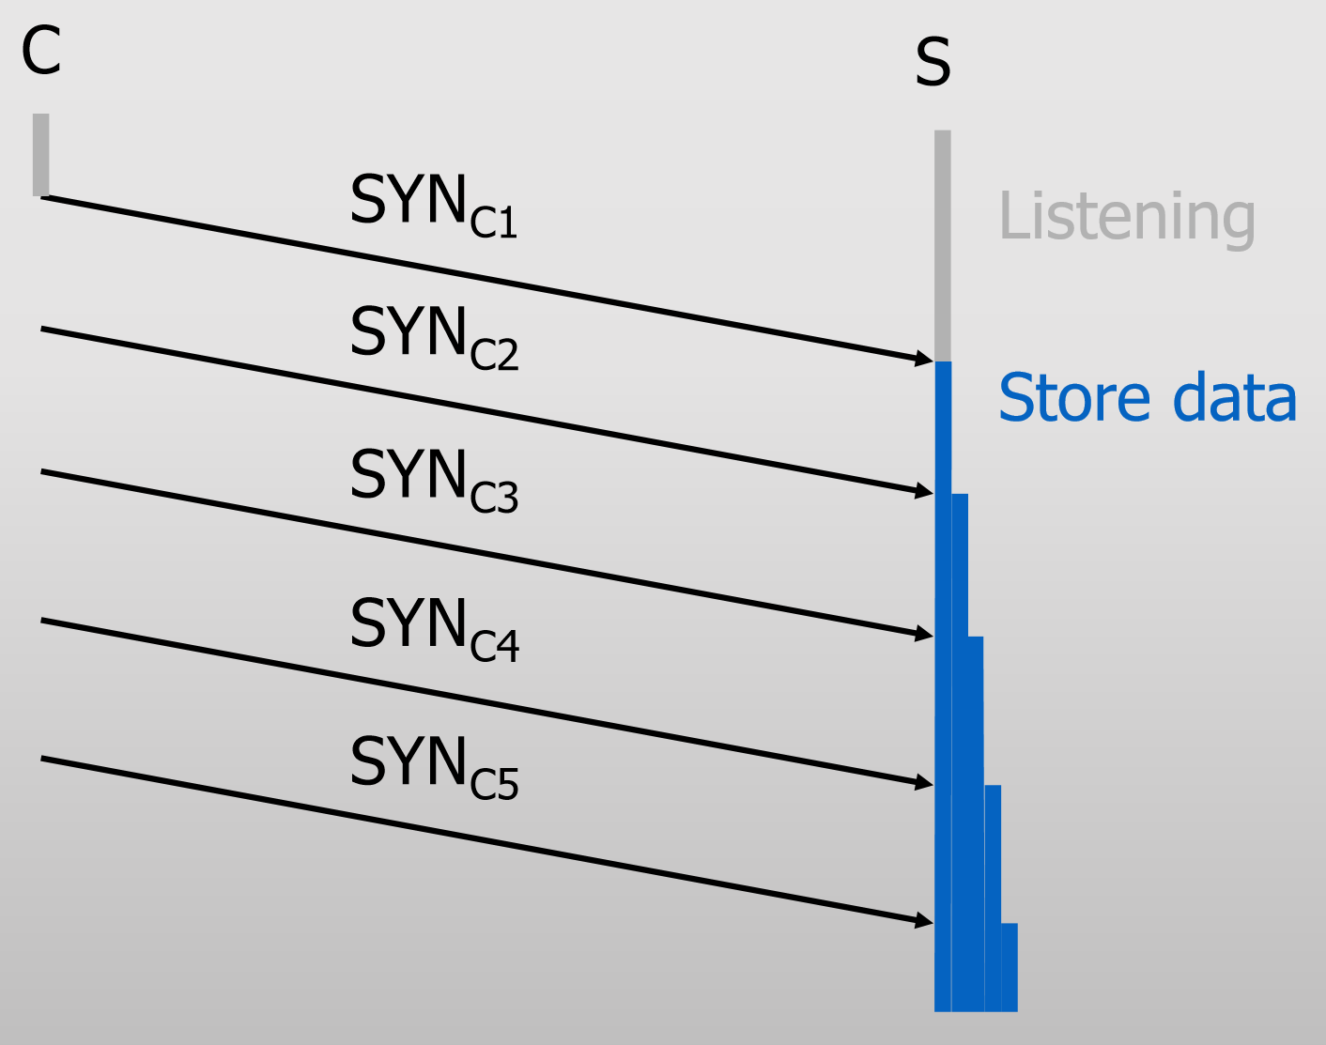
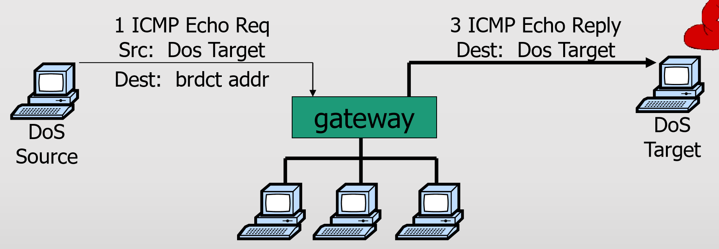
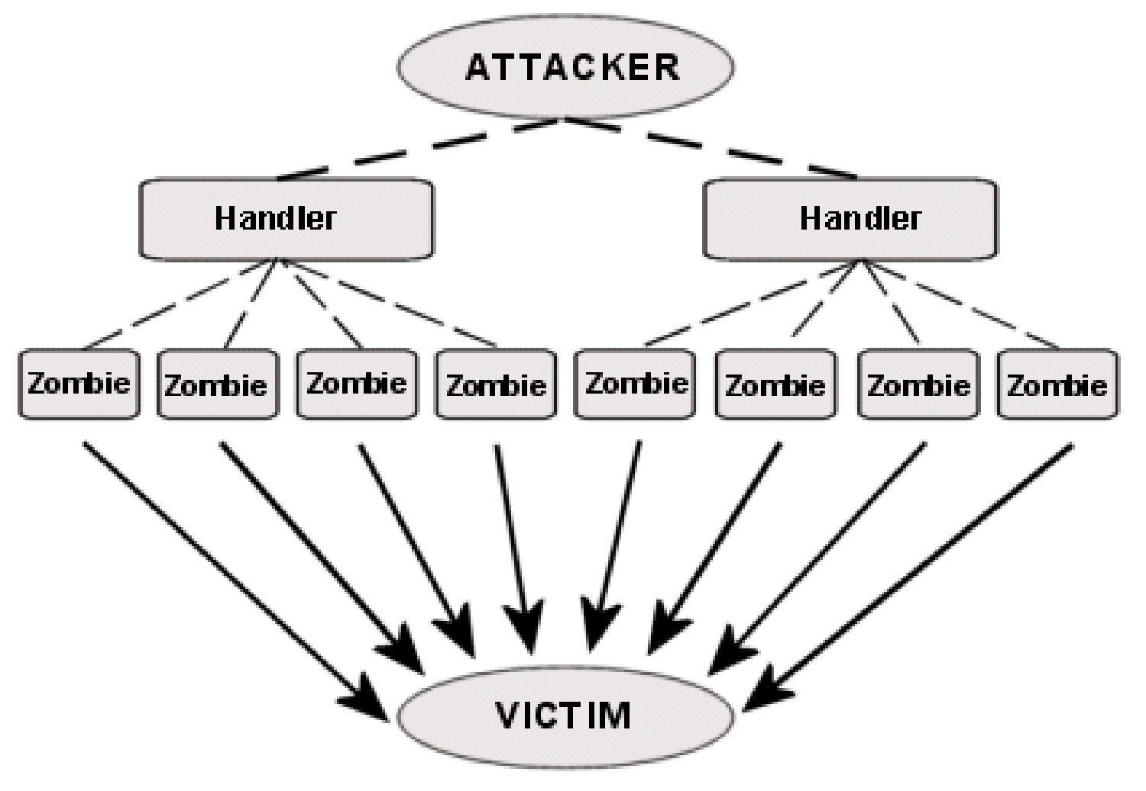
Denial-of-service Attacks:
A denial-of-service attack (DoS attack) is a cyber-attack in which the perpetrator seeks to make a machine or network resource unavailable to its intended users by temporarily or indefinitely disrupting services of a host connected to the Internet. ---(Wiki)
SYN Flooding
Smurf DoS Attack
Distributed DoS (DDoS) Attack
Internet Control Message Protocol (ICMP)
• Provides feedback about network operation
• Error reporting
• Reachability testing
• Congestion Control
• Attacker sends many connection requests
• Spoofed source addresses
• Victim allocates resources for each request
• Connection requests exist until timeout
• Resources exhausted => requests rejected
• Attacker: Send ping request to broadcast addr (ICMP Echo Req)
• Victim receives lots of responses:
• Every host on target network generates a ping reply (ICMP Echo Reply) to victim
• Ping reply stream can overload victim
Prevention: reject external packets to broadcast address
Such an attack is often the result of multiple compromised systems (for example, a botnet) flooding the targeted system with traffic.
A botnet is a network of zombie computers programmed to receive commands without the owners' knowledge.
When a server is overloaded with connections, new connections can no longer be accepted.

Slide 11
Pharming
DNS Cache Poisoning

Slide 12
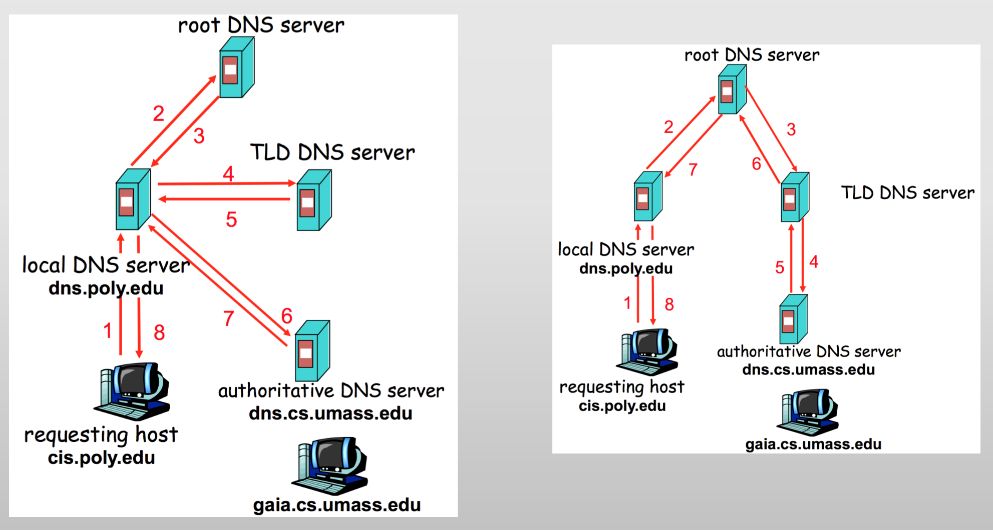
Domain Name System (DNS):
• Translate host names to IP addresses
• E.g., www.xyz.com ➔ 74.125.91.103
• And back
• From IP addresses to DNS name
DNS Resolving:
Domain Name Servers:
• Top-level domain (TLD) servers:
• responsible for com, org, net, edu, etc, and all top-level country domains, e.g. uk, fr, ca, jp.
• Authoritative DNS servers:
• organization’s DNS servers, providing authoritative hostname to IP mappings for organization’s servers.
• can be maintained by organization or service provider.
• Local Name Server
• does not strictly belong to hierarchy
• each ISP (residential ISP, company, university) has one.
1. DNS responses are cached
2. Negative results are also cached
3. Cached data periodically times out

Slide 13
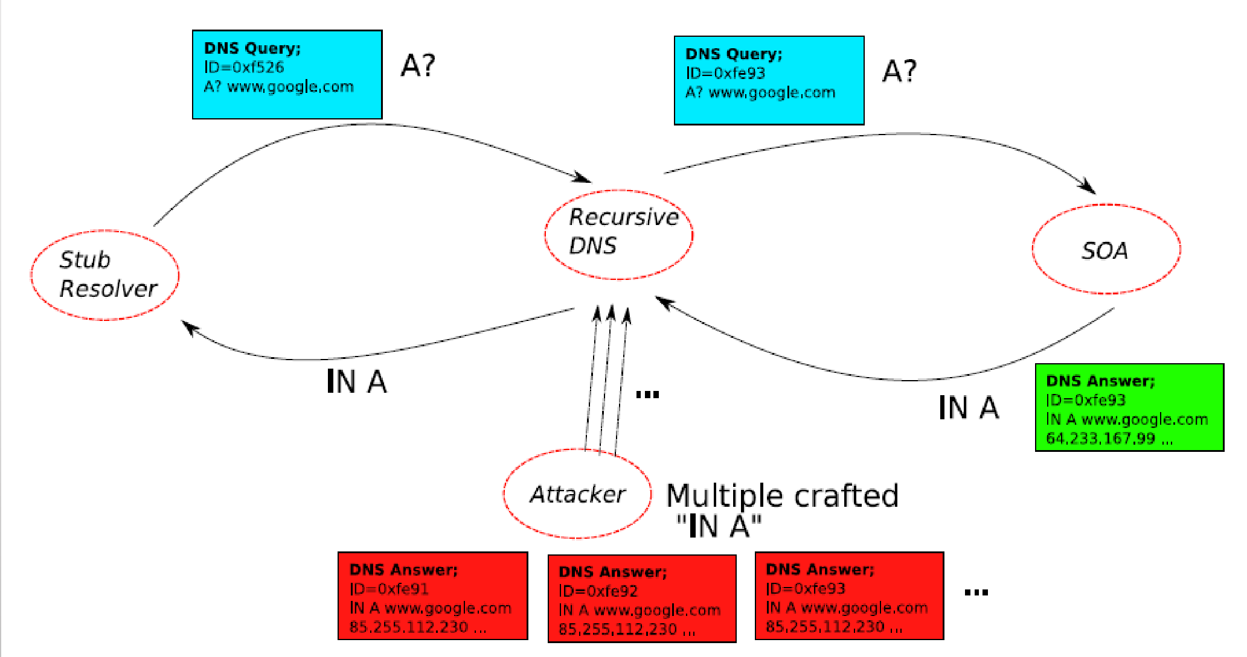
1. Pharming
• Exploit DNS poisoning attack
• Change IP addresses to redirect URLs to fraudulent sites
2. DNS Cache Poisoning
• Attacker wants his IP address returned for a DNS query
• When the resolver asks ns1.google.com for www.google.com, the attacker could reply first, with his own IP
• Transaction ID
• 16-bit random number
• The real server knows the number, because it was contained in the query
• The attacker has to guess
• Responding before the real nameserver
• An attacker can guess when a DNS cache entry times out and a query has been sent, and provide a fake response.
• The fake response will be accepted only when its 16-bit transaction ID matches the query
(Birthday attack? Kaminsky attack? Defenses?)
Racing to Respond First:

Slide 14
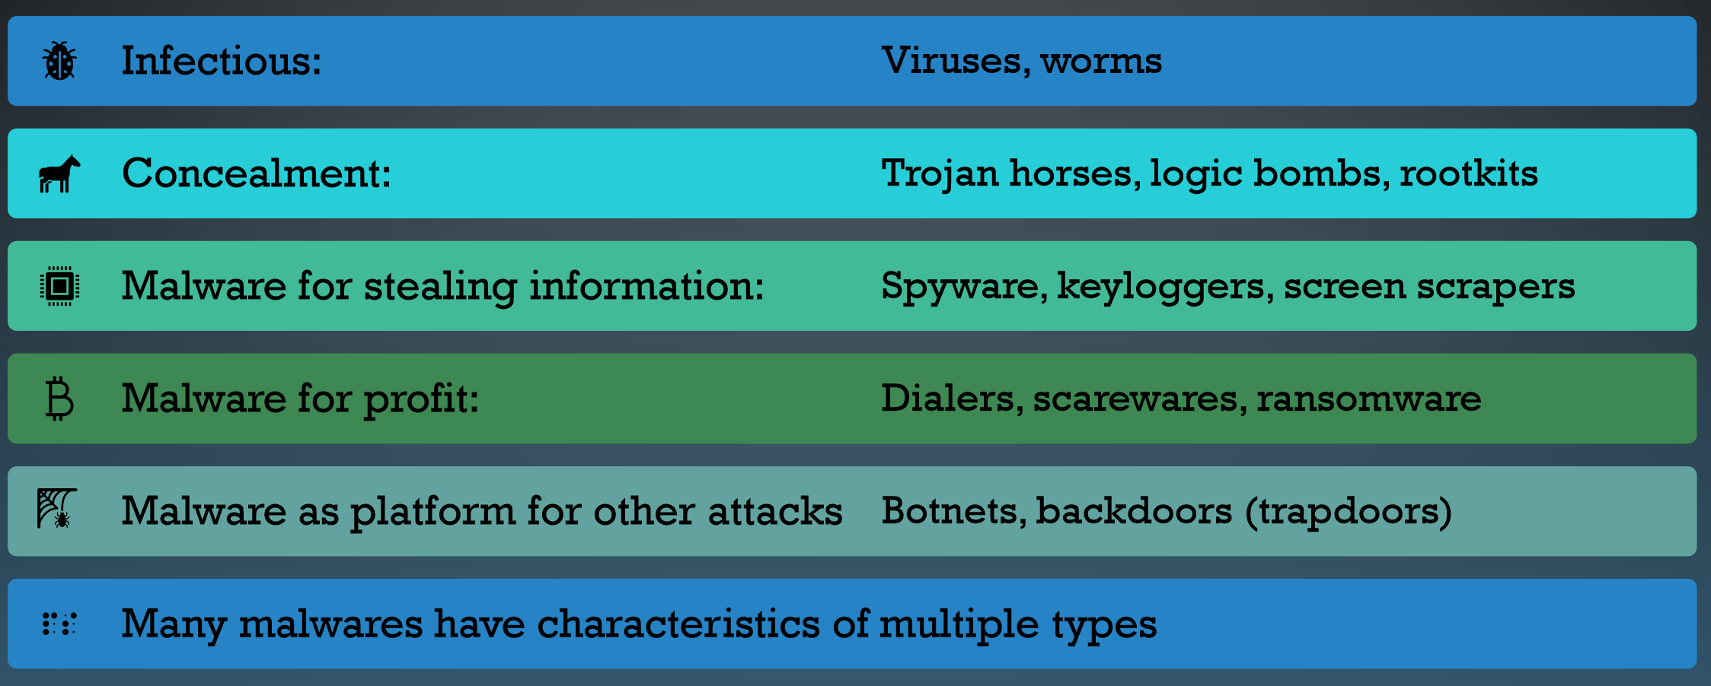
Malwares Features and Types

Slide 15
TROJAN HORSE: Software that appears to perform a desirable function for the user prior to run or install, but (perhaps in addition to the expected function) steals information or harms the system.
• User tricked into executing Trojan horse
• Expects (and sees) overt and expected behavior
• Covertly perform malicious acts with user’s authorization

Slide 16
TRAPDOOR OR BACKDOOR
• Secret entry point into a system
• Specific user identifier or password that circumvents normal security procedures.
• Commonly used by developers
• Could be included in a compiler.

Slide 17
LOGIC BOMB
• Embedded in legitimate programs
• Activated when specified conditions met
• E.g., presence/absence of some file; Particular date/time or particular user
• When triggered, typically damages system
• Modify/delete files/disks

Slide 18
SPYWARE
• Malware that collects little bits of information at a time about users without their knowledge
• Keyloggers: stealthy tracking and logging key strokes
• Screen scrapers: stealthy reading data from a computer display
• May also tracking browsing habit
• May also re-direct browsing and display ads

Slide 19
SCAREWARE
• Malware that scares victims into take actions that ultimately end up compromising our own security.
• E.g., paying for and installing fake anti-virus products

Slide 20
RANSOMWARE
• Holds a computer system, or the data it contains, hostage against its user by demanding a ransom
• Disable an essential system service or lock the display at system startup
• Encrypt some of the user's personal files, originally referred to as cryptoviruses, cryptotrojans or cryptoworms
• Victim user has to
• enter a code obtainable only after wiring payment to the attacker or sending an SMS message
• buy a decryption or removal tool

Slide 21
VIRUS
• Attach itself to a host (often a program) and replicate itself
• Self-replicating code
• Self-replicating Trojan horses
• Alters normal code with “infected” version

Slide 22
WORM
Self-replicating malware that does not require a host program
• Propagates a fully working version of itself to other machines
• Carries a payload performing hidden tasks
• Backdoors, spam relays, DDoS agents; …
• Examples: Morris Worm, Slammer Worms, Warhol Worms, Flash Worms, Email Worms, Nimda Worm, STUXNET
(properties, features, differences, similarities)

Slide 23
ROOTKIT
• A rootkit is software that enables continued privileged access to a computer while actively hiding its presence from administrators by subverting standard operating system functionality or other applications.
• Emphasis is on hiding information from administrators’ view, so that malware is not detected
• E.g., hiding processes, files, opened network connections, etc
• Example: Sony BMG copy protection rootkit scandal

Slide 24
ZOMBIE & BOTNET
• Secretly takes over another networked computer by exploiting software flows
• Builds the compromised computers into a zombie network or botnet
• a collection of compromised machines running programs, usually referred to as worms, Trojan horses, or backdoors, under a common command and control infrastructure.
• Uses it to indirectly launch attacks
• E.g., DDoS, phishing, spamming, cracking
• Example: Storm Botnet

Slide 25
OS BASICS
WHAT SECURITY GOALS DOES OPERATING SYSTEM PROVIDE?
• Ensure secure operation in networked environment
• Security mechanisms
• Authentication
• Access Control
• Secure Communication (using cryptography)
• Logging & Auditing
• Intrusion Prevention and Detection
• Recovery

Slide 26
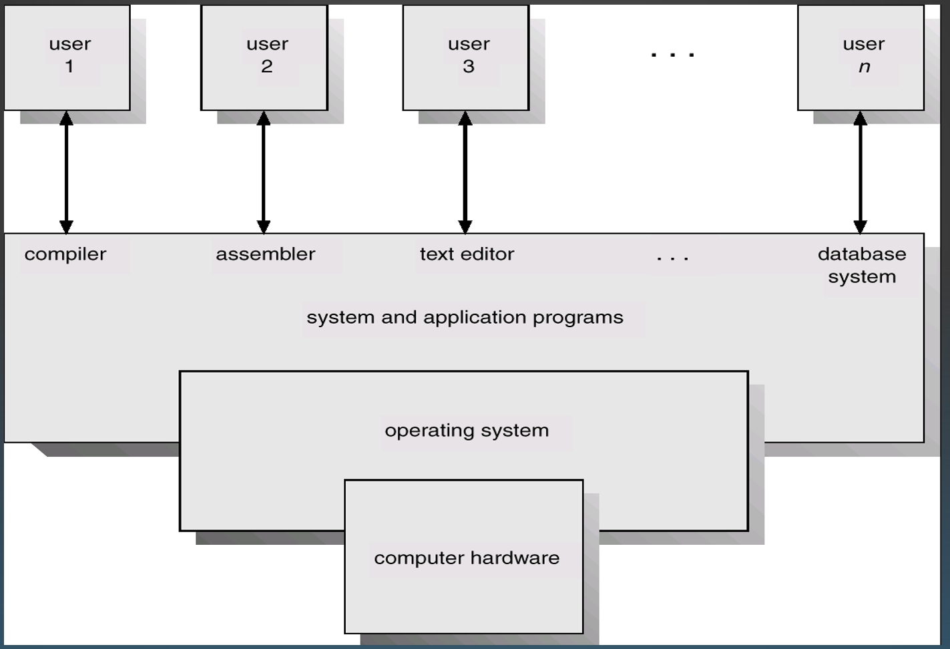
OS BASICS
SYSTEM COMPONENTS
• Hardware
• Provides basic computing resources (CPU, memory, I/O devices).
• Operating system
• Controls and coordinates the use of the hardware among the various application programs.
• Applications programs
• Define the ways in which the system resources are used to solve the computing problems of the users.
• Users
• E.g., people, machines, other computers.
Abstract View:

Slide 27
MEMORY PROTECTION: ACCESS CONTROL TO MEMORY
• Ensures that one user’s process cannot access other’s memory
• fence
• relocation
\ • base/bounds register
• segmentation
• paging
• …
• Operating system and user processes need to have different privileges
CPU MODES (A.K.A. PROCESSOR MODES OR PRIVILEGE MODES)
• System mode (privileged mode, master mode, kernel mode)
• Can execute any instruction
• Can access any memory locations, e.g., accessing hardware devices,
• Can enable and disable interrupts,
• Can change privileged processor state,
• Can access memory management units,
• Can modify registers for various descriptor tables .
USER MODE
• User mode
• Access to memory is limited,
• Cannot execute some instructions
• Cannot disable interrupts,
• Cannot change arbitrary processor state,
• Cannot access memory management units
Transition from user mode to system mode can only happen via well defined entry points, i.e., through system calls
Notes:
Vidgenni e

Slide 28
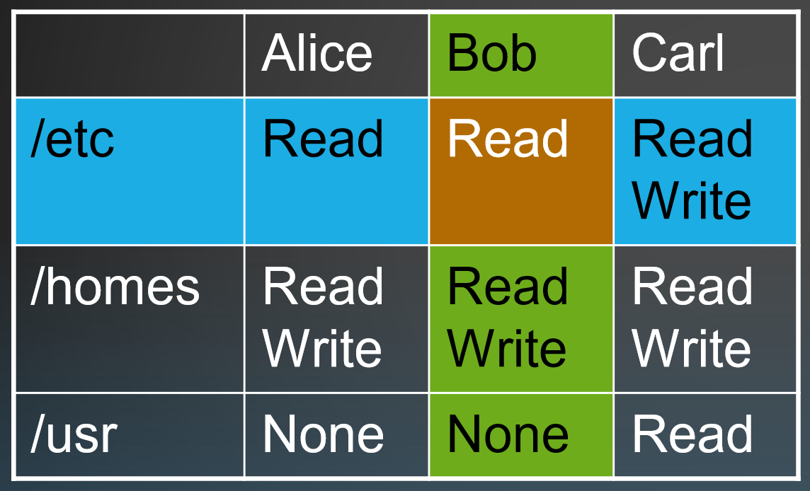
AUTHORIZATION
How does the system know what I’m allowed to do?
• Authorization matrix:
• Objects = things that can be accessed
• Subjects = things that can do the accessing (users or programs)
• What are the limits?
• Time of day
• Ranges of values
ACLs: Can have large numbers of objects. Easy to grant access to many objects at once. Require expensive operation on every access.
Capabilities: Hard to manage huge number of capabilities. They have to come from somewher. They are fast to use (just pointer dereferences).
Most systems use both: ACLs for opening an object (e.g. fopen()), Capabilities for performing operations (e.g. read())
ACCESS CONTROL LISTS & CAPABILITIE LISTS
In Access Control List (ACL) each object has a list of (action, user-list) tuple.
/etc: ((read, {Alice}), (read, {Bob}), (r/w, {Carl}))
/homes: ((r/w, {Alice}), (r/w, {Alice}), (r/w, {Carl}))
On the other hand, in the capability list system which is a counter-part of ACL system, a user is associated with a list of (action, object-list) tuple.
Alice: ((read, {/etc, /homes}), (write, {/homes}))
Bob: ((read, {{/etc, /homes}), (write, {/homes}))

Slide 29
BASIC CONCEPTS OF UNIX ACCESS CONTROL
USERS, GROUPS, FILES, PROCESSES
• Each user account has a unique UID
• The UID 0 means the super user (system admin)
• A user account belongs to multiple groups
• Subjects are processes
• associated with uid/gid pairs, e.g., (euid, egid), (ruid, rgid), (suid, sgid)
• Objects are files
• Almost all objects are modeled as files
• Files are arranged in a hierarchy
• Files exist in directories
• Directories are also one kind of files
•Each object has
• owner
• group
• 12 permission bits
PERMISSION BITS ON DIRECTORIES

Slide 30
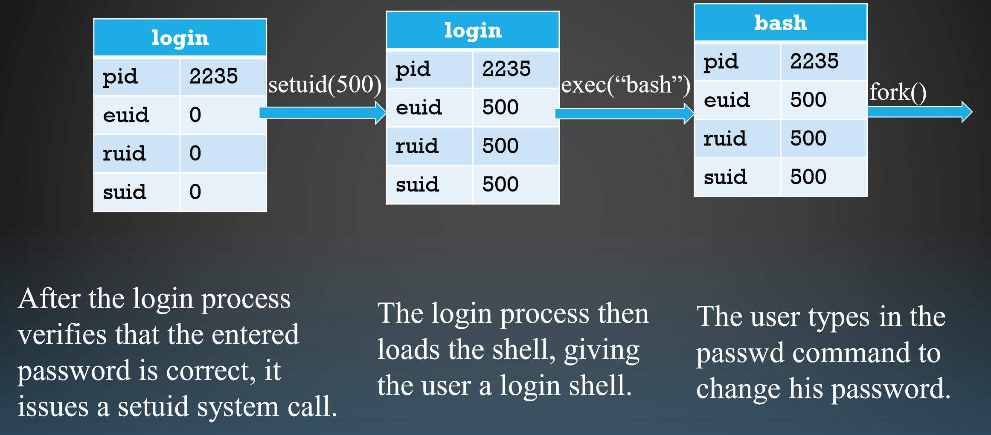
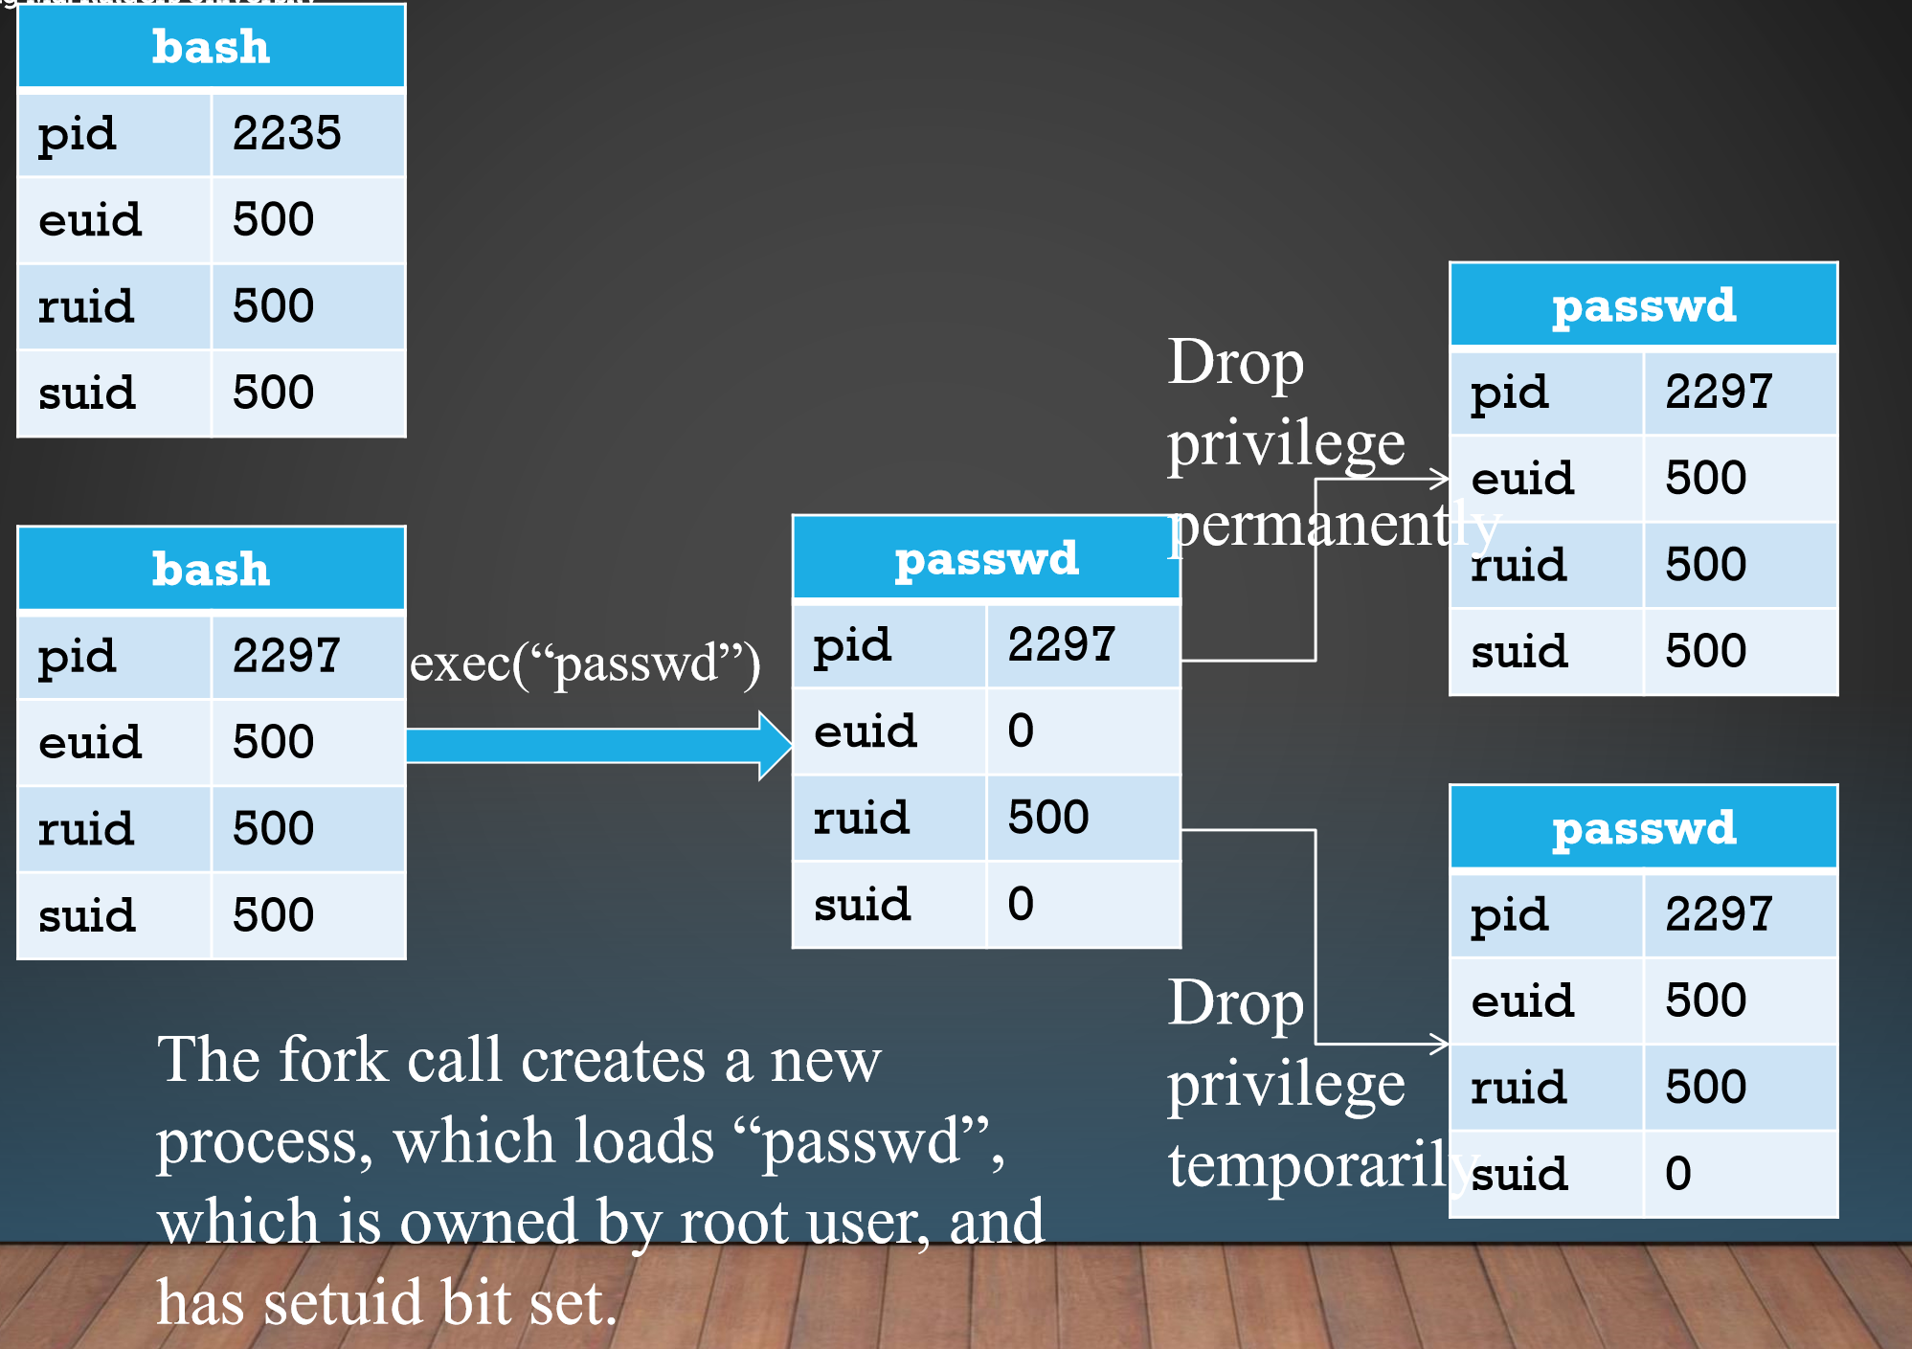
PROCESS USER ID MODEL IN MODERN UNIX SYSTEM
• Each process has three user IDs
• real user ID (ruid) owner of the process
• effective user ID (euid) used in most access control decisions
• saved user ID (suid)
• and three group IDs
• real group ID
• effective group ID
• saved group ID
• When a process is created by fork
• it inherits all three users IDs from its parent process
• When a process executes a file by exec
• it keeps its three user IDs unless the set-user-ID bit of the file is set, in which case the effective uid and saved uid are assigned the user ID of the owner of the file
• A process may change the user ids via system calls
• A process that executes a set-uid program can drop its privilege; it can
• drop privilege permanently
• removes the privileged user id from all three user IDs
• drop privilege temporarily
• removes the privileged user ID from its effective uid but stores it in its saved uid, later the process may restore privilege by restoring privileged user ID in its effective uid

